Slide 1
MICROOPERATION
Register Transfer Language
An elementary operation performed during
one clock pulse, on the information stored
in one or more registers
Registers
(R)
ALU
(f)
1 clock cycle
R ← f(R, R)
f: shift, count, clear, load, add,...

Slide 2
REGISTER TRANSFER LANGUAGE
Register Transfer Language
Definition of the (internal) organization of a computer
- Set of registers and their functions
- Microoperations Set
Set of allowable microoperations provided
by the organization of the computer
- Control signals that initiate the sequence of
microoperations
For any function of the computer, a sequence of
microoperations is used to describe it
----> Register transfer language
- A symbolic language
- A convenient tool for describing the
internal organization of digital computers
- Can also be used to facilitate the design
process of digital systems.

Slide 3
REGISTER TRANSFER
Register Transfer
Designation of a register
- a register
- portion of a register
- a bit of a register
Common ways of drawing the block diagram of a register
Register
Showing individual bits
R1
7 6 5 4 3 2 1 0
15
0
15
8
7
0
R2
PC(H)
PC(L)
Numbering of bits
Subfields
Representation of a transfer(parallel)
R2 ← R1
A simultaneous transfer of all bits from the
source to the destination register, during one clock pulse
Representation of a controlled(conditional) transfer
P: R2 ← R1
A binary condition(p=1) which determines when the transfer
is to occur
If (p=1) then (R2 ← R1)

Slide 4
HARDWARE IMPLEMENTATION OF CONTROLLED TRANSFERS
Register Transfer
Implementation of controlled transfer
P: R2 ← R1
Block diagram
Control
Circuit
P
Load
R2
Clock
n
R1
Timing diagram
t
t+1
Clock
Load
Transfer occurs here
Basic Symbols for Register Transfers
Symbols
Description Meaning
Capital letters Denotes a register MAR, R2
and numerals
Parentheses ( ) Denotes a part of a register R2(0-7), R2(L)
Arrow ← Denotes transfer of information R2 ← R1
Colon : Denotes termination of control function P:
Comma , Separates two micro-operations A ← B, B ← A

Slide 5
Register Transfer
Data can move from register to register.
Digital logic used to process data
for example:
C ← A + B
Register A
Register B
Digital Logic
Circuits
Register C

Slide 6
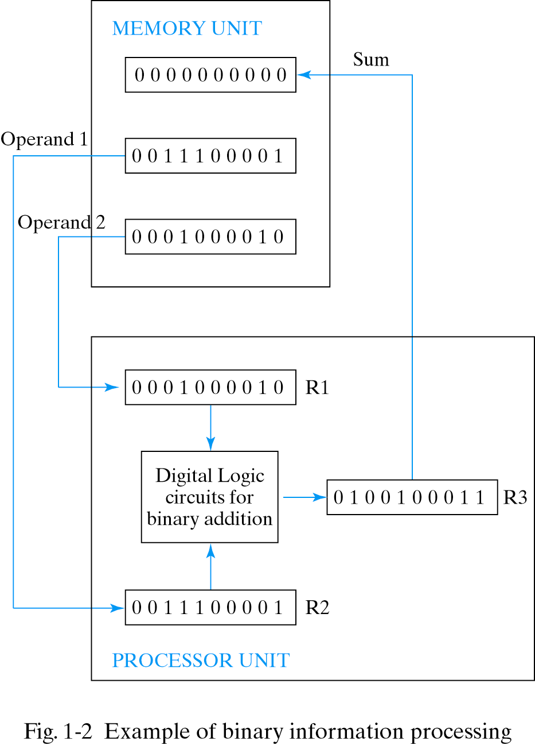
Building a Computer
Needs:
processing
storage
communication
Notes:
6

Slide 7
Bus 1
S₁
Bus 0
S₀
Mux ₁
Mux ₀
3
2
1
0
3
2
1
0
D1 | D0
C1 | C0
B1 | B0
A1 | A0

Slide 8
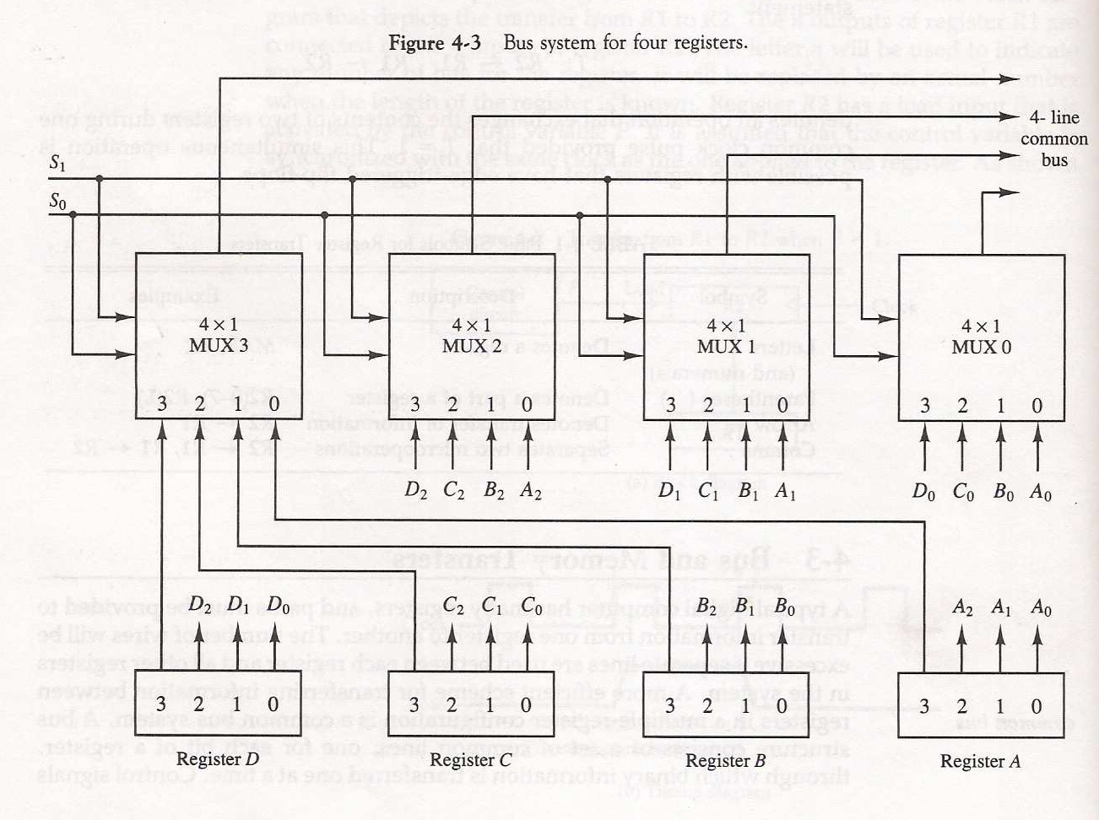

Slide 9
Bus Transfer
For register R0 to R3 in a 4 bit system
4-line
common
bus
S1
S0
Register D
Register C
Register B
Register A
Used for highest bit from each register
Used for lowest bit

Slide 10
The number of multiplexer needed to construct the bus=n n:number of bits in each register
The size of each multiplexer= k *1
K: number of register
Example:
Common bus for eight of register of 16-bit each, requires a 16 multiplexer of size 8X1 and 3 selection line

Slide 11
Question
For register R0 to R63 in a 16 bit system:
What is the MUX size we use?
How many MUX we need?
How many select bit?

Slide 12
Three-State Bus Buffers
A bus system can be constructed with three-state gates instead of multiplexers
Tri-State : 0, 1, High-impedance(Open circuit)
Buffer
A device designed to be inserted between other devices to match impedance, to prevent mixed interactions.

Slide 13
Tri-state buffer gate
Tri-state buffer gate : Fig. 4-4
When control input C=1 : The output is enabled(output Y = input A)
When control input C=0 : The output is disabled(output Y = high-impedance)
Normal input A
If C=1, Output Y = A
If C=0, Output = High-impedance
Control input C

Slide 14
The construction of a bus system with tri-state buffer
A0
B0
C0
D0
Select input
Enable input

Slide 15
Memory Transfer
The transfer of information from a memory word to the outside environment is called a read operation
The transfer of new information to be stored into the memory is called a write operation

Slide 16
Memory Read and Write
AR: address register
DR: data register
Read: DR ← M[AR]
Write: M[AR] ← R1
Memory
unit
Read
AR
Write
DR

Slide 17
Bus and Memory Transfers
Summary of Register Transfer Microoperations
A ← B Transfer content of reg. B into reg. A
AR ← DR(AD) Transfer content of AD portion of reg. DR into reg. AR
A ← constant Transfer a binary constant into reg. A
ABUS ← R1, Transfer content of R1 into bus A and, at the same time,
R2 ← ABUS Transfer content of bus A into R2
M[R] Memory word specified by reg. R
M Equivalent to M[AR]
DR ← M Memory read operation: transfers content of
memory word specified by AR into DR
M ← DR Memory write operation: transfers content of
DR into memory word specified by AR

Slide 18
ARITHMETIC MICROOPERATIONS
Arithmetic Microoperations
Four types of microoperations
- Register transfer microoperations
- Arithmetic microoperations
- Logic microoperations
- Shift microoperations

Slide 19
Arithmetic Microoperations
Symbolic designation Description
R3 ← R1 + R2 Contents of R1 plus R2 transferred to R3 R3 ← R1 – R2 Contents of R1 minus R2 transferred to R3 R2 ← R2 Complement the contents of R2 (1’s complement) R2 ← R2 + 1 2’s Complement the contents of R2 (negate) R3 ← R1 + R2 + 1 R1 plus the 2’s complement of R2 (subtract) R1 ← R1 + 1 Increment the contents of R1 by one R1 ← R1 – 1 Decrement the contents of R1 by one
Multiplication and division are not basic arithmetic operations
Multiplication : R0 = R1 * R2
Division : R0 = R1 / R2

Slide 20
Arithmetic Microoperations
A single circuit does both arithmetic addition and subtraction depending on control signals.
• Arithmetic addition:
R3 ← R1 + R2 (Here + is not logical OR. It denotes addition)

Slide 21
Arithmetic Microoperations
Arithmetic subtraction:
R3 ←R1 + R2 + 1
where R2 is the 1’s complement of R2.
Adding 1 to the one’s complement is equivalent to taking the 2’s complement of R2 and adding it to R1.

Slide 22
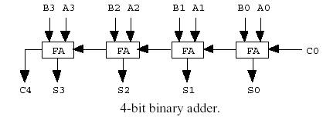
BINARY ADDER
Binary adder is constructed with full-adder circuits connected in cascade.

Slide 23
BINARY ADDER-SUBTRACTOR
• The addition and subtraction operations cane be combined into one common circuit by including an exclusive-OR gate with each full-adder.
XOR
M b
0 0 0
0 1 1
1 0 1
1 1 0

Slide 24
BINARY ADDER-SUBTRACTOR
M = 0: Note that B XOR 0 = B. This is exactly the same as the binary adder with carry in C0 = 0.
M = 1: Note that B XOR 1 = B (flip all B bits). The outputs of the XOR gates are thus the 1’s complement of B.
M = 1 also provides a carry in 1. The entire operation is: A + B + 1.
For unsigned number this give A-B if A>=B or the 2’s complement of (B-A) if A<B

Slide 25
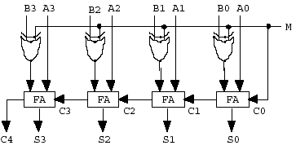
BINARY ADDER-SUBTRACTOR

Slide 26
4-bit Binary Incrementer
Adds one to a number in a register
Sequential circuit implementation using binary counter
Combinational circuit implementation using Half Adder
The least significant HA bit is connected to logic-1
The output carry from one HA is connected to the input of the next-higher-order HA

Slide 27
4-bit Binary Incrementer
B3 B2 B1 B0 1
Always added to 1
C4
S3 S2 S1 S0

Slide 28
BINARY ADDER
Arithmetic Microoperations
Binary Adder
Binary Adder-Subtractor
Binary Incrementer

Slide 29
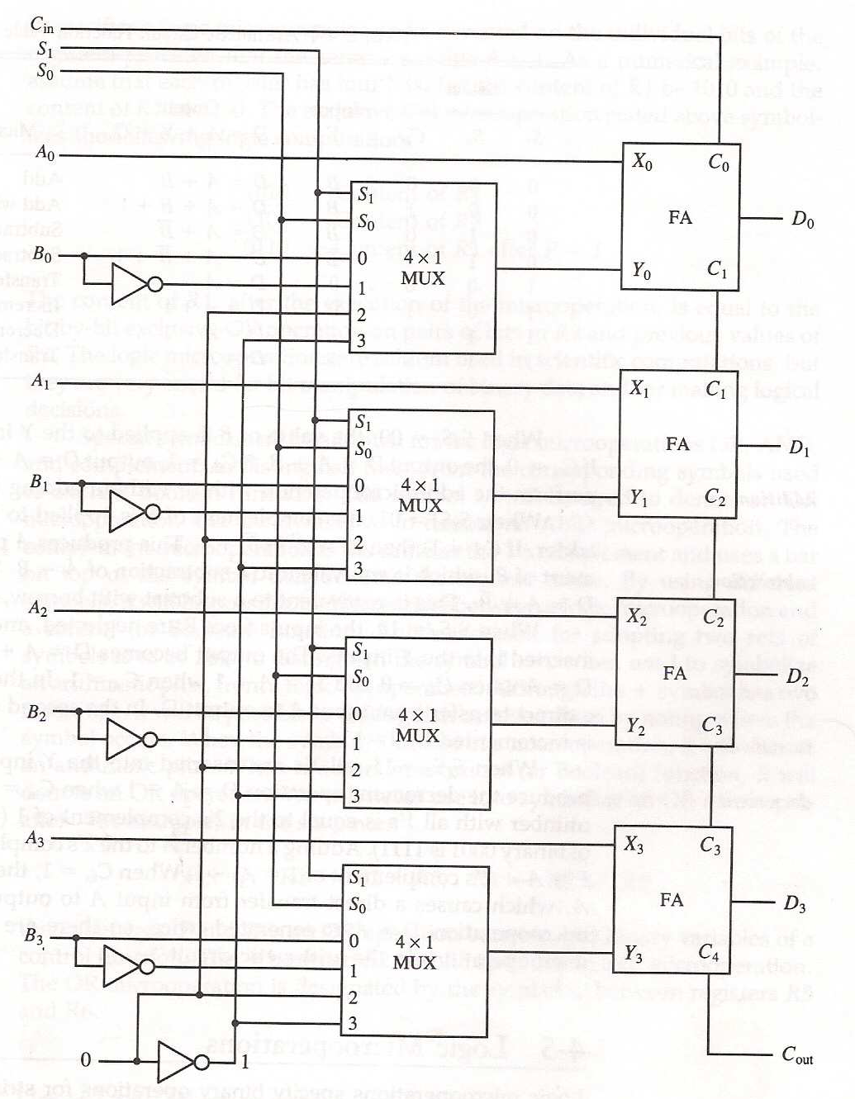
D=A+Y+Cn

Slide 30
ARITHMETIC CIRCUIT
Arithmetic Microoperations
Cin
S1
S0
A0
X0
C0
S1
FA
D0
B0
S0
4x1
Y0
C1
0
1
MUX
2
3
A1
X1
C1
S1
FA
D1
B1
S0
4x1
Y1
C2
0
1
MUX
2
3
A2
X2
C2
S1
FA
D2
B2
S0
4x1
Y2
C3
0
1
MUX
2
3
A3
X3
C3
S1
FA
D3
B3
S0
4x1
Y3
C4
0
1
MUX
2
Cout
0
1
3
S1 S0 Cin Y Output Microoperation
0 0 0 B D = A + B Add
0 0 1 B D = A + B + 1 Add with carry
0 1 0 B’ D = A + B’ Subtract with borrow
0 1 1 B’ D = A + B’+ 1 Subtract
1 0 0 0 D = A Transfer A
1 0 1 0 D = A + 1 Increment A
1 1 0 1 D = A - 1 Decrement A
1 1 1 1 D = A Transfer A

Slide 31
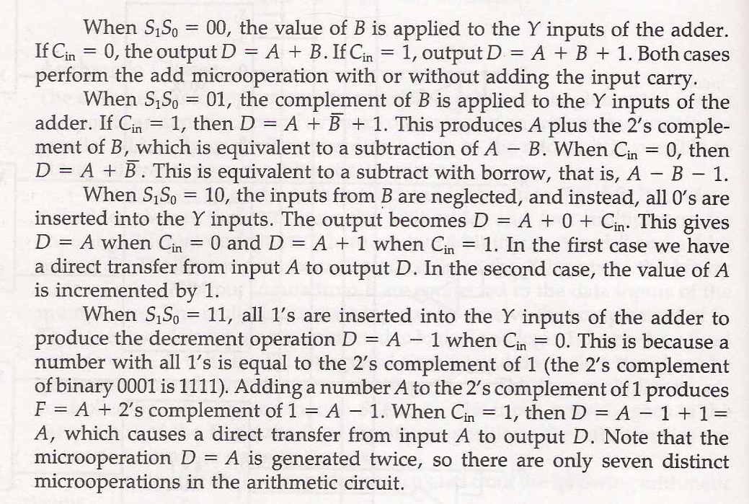

Slide 32
LOGIC MICROOPERATIONS
Logic Microoperations
Specify binary operations on the strings of bits in registers.
- useful for bit manipulations on binary data
AND: Mask out certain group of bits
OR : Merge binary or character data
- useful for making logical decisions based on the bit value
Use ۷ to denote OR and ۸ to denote AND
Use + only with production not with registers.
P+Q: R1←R2+R3 , R4 ← R5 ۷ R6

Slide 33
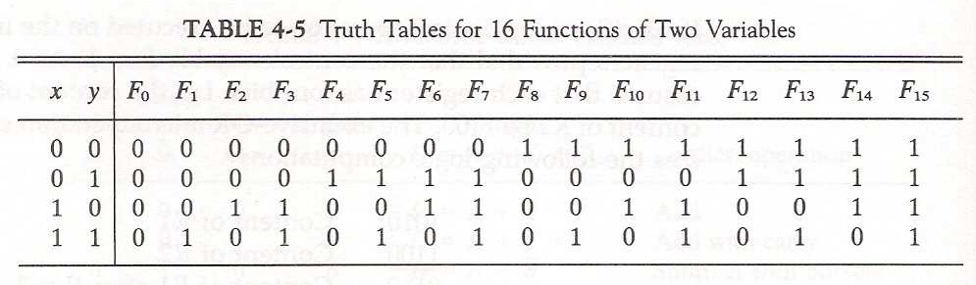

Slide 34
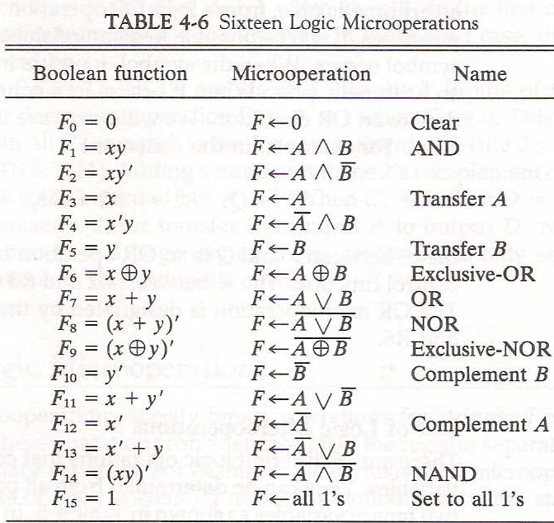

Slide 35
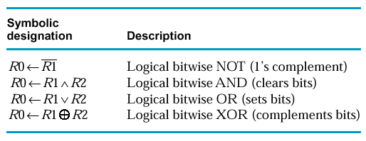
4.5 Logic Microoperations
Manipulating the bits stored in a register
Logic Microoperations
Notes:
35

Slide 36
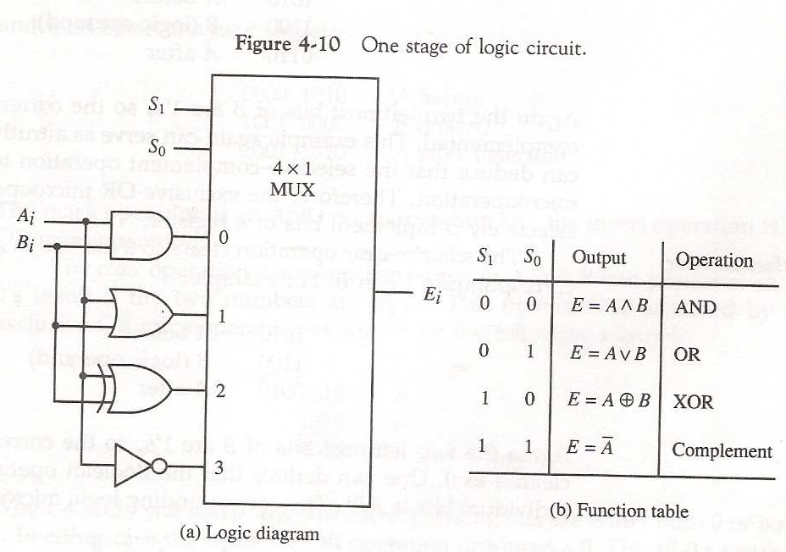

Slide 37
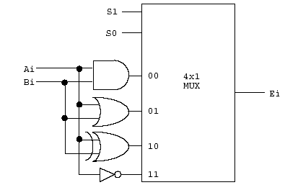
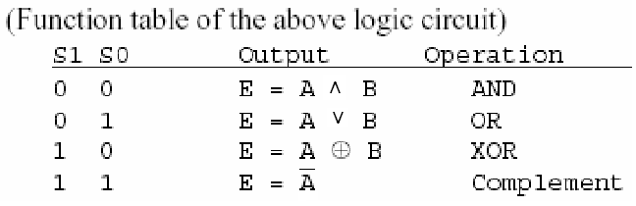
LOGIC CIRCUIT
• A variety of logic gates are inserted for each bit of registers. Different bitwise logical operations are selected by select signals.
Notes:
37

Slide 38
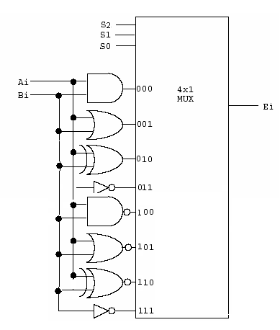
Example
Extend the previous logic circuit to accommodate XNOR, NAND, NOR, and the complement of the second input.
S2 | S1 | S0 | Output | Operation
0 | 0 | 0 | X ∧ Y | AND
0 | 0 | 1 | X ∨ Y | OR
0 | 1 | 0 | X ⊕ Y | XOR
0 | 1 | 1 | A | Complement A
1 | 0 | 0 | (X ∧ Y) | NAND
1 | 0 | 1 | (X ∨ Y) | NOR
1 | 1 | 0 | (X ⊕ Y) | XNOR
1 | 1 | 1 | B | Complement B
Notes:
38

Slide 39
More Logic Microoperation
X Y F₀ F₁ F₂ F₃ F₄ F₅ F₆ F₇ F₈ F₉ F₁₀ F₁₁ F₁₂ F₁₃ F₁₄ F₁₅
0 0 0 0 0 0 0 0 0 0 1 1 1 1 1 1 1 1 0 1 0 0 0 0 1 1 1 1 0 0 0 0 1 1 1 1 1 0 0 0 1 1 0 0 1 1 0 0 1 1 0 0 1 1 1 1 0 1 0 1 0 1 0 1 0 1 0 1 0 1 0 1
TABLE 4-5. Truth Table for 16 Functions of Two Variables
Boolean function Microoperation Name
F₀ = 0 F ← 0 Clear F₁ = xy F ← A∧B AND F₂ = xy’ F ← A∧B F₃ = x F ← A Transfer A F₄ = x’y F ← A∧B F₅ = y F ← B Transfer B F₆ = x ⊕ y F ← A ⊕B Ex-OR F₇ = x+y F ← A∨B OR
Boolean function Microoperation Name
F₈ = (x+y)’ F ← A∨B NOR F₉ = (x ⊕ y)’ F ← A ⊕B Ex-NOR F₁₀ = y’ F ← B Compl-B F₁₁ = x+y’ F ← A∨B F₁₂ = x’ F ← A Compl-A F₁₃ = x’+y F ← A∨B F₁₄ = (xy)’ F ← A∧B NAND F₁₅ = 1 F ← all 1’s set to all 1’s
TABLE 4-6. Sixteen Logic Microoperations
Notes:
39

Slide 40
Homework 1
Design a multiplexer to select one of the 16 previous functions.
Notes:
40

Slide 41
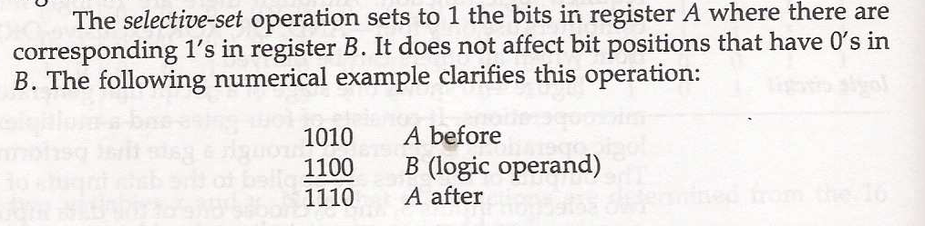
Selective-set

Slide 42
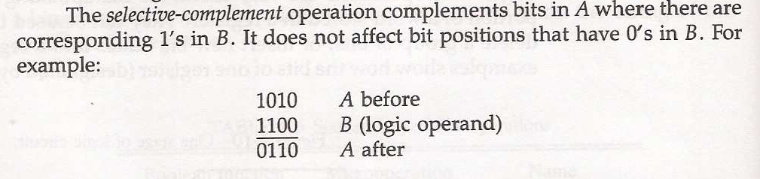
Selective-complement

Slide 43
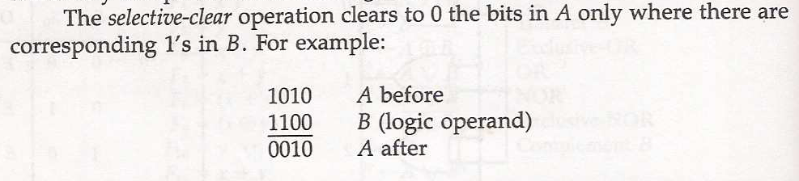
Selective-clear

Slide 44
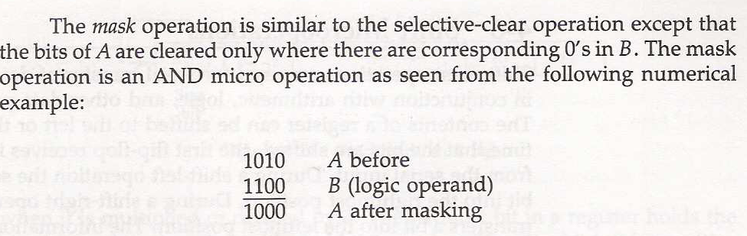
Mask

Slide 45
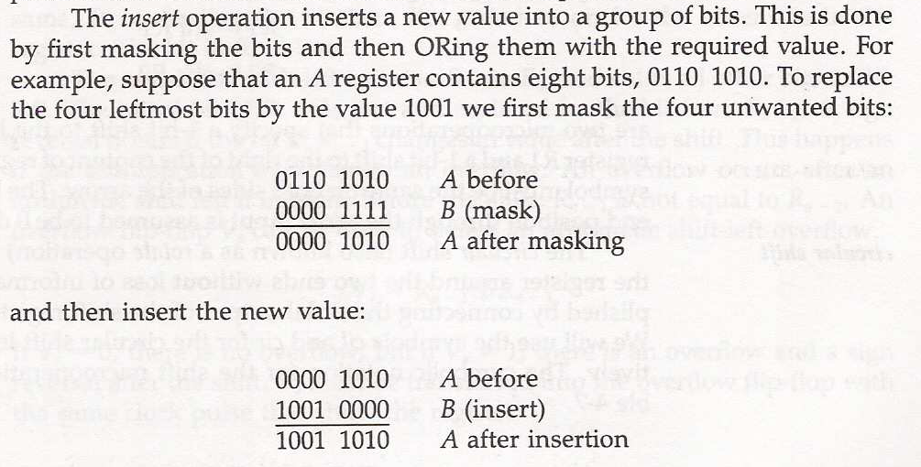
Insert

Slide 46
Clear_Example
Logic operation can…
clear a group of bit values (Anding the bits to be cleared with zeros)
10101101 10101011 R1 (data)
00000000 11111111 R2 (mask)
00000000 10101011 R1

Slide 47
Set_Example
set a group of bit values (Oring the bits to be set to ones with ones)
10101101 10101011 R1 (data)
11111111 00000000 R2 (mask)
11111111 10101011 R1

Slide 48
Insert_Example
Insert
The insert operation inserts a new value into a group of bits
This is done by first masking the bits and then ORing them with the required value
1) Mask 2) OR
0110 1010 A before 0000 1010 A before
0000 1111 B mask 1001 0000 B insert
0000 1010 A after mask A ∧ B 1001 1010 A after insert AVB

Slide 49
Complement_Example
Complement a group of bit values (Exclusively Or (XOR) the bits to be complemented with ones)
10101101 10101011 R1 (data)
11111111 00000000 R2 (mask)
01010010 10101011 R1

Slide 50
4-6 Shift Microoperations
Shift example: 11000
Shift Microoperations :
Shift microoperations are used for serial transfer of data
Three types of shift microoperation : Logical, Circular, and Arithmetic

Slide 51
Shift Microoperations
Symbolic designation Description
R ← shl R Shift-left register R R ← shr R Shift-right register R R ← cil R Circular shift-left register R R ← cir R Circular shift-right register R R ← ashl R Arithmetic shift-left R R ← ashr R Arithmetic shift-right R
TABLE 4-7. Shift Microoperations

Slide 52
Logical Shift
A logical shift transfers 0 through the serial input
The bit transferred to the end position through the serial input is assumed to be 0 during a logical shift (Zero inserted)
0
0

Slide 53
Logical Shift Example
1. Logical shift: Transfers 0 through the serial input.
R1 ← shl R1 Logical shift-left
R2 ← shr R2 Logical shift-right
(Example) Logical shift-left
10100011 → 01000110

Slide 54
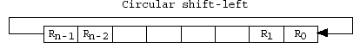
Circular Shift
The circular shift circulates the bits of the register around the two ends without loss of information

Slide 55
Circular Shift Example
Circular shift-left
Circular shift-right
(Example) Circular shift-left
10100011 is shifted to 01000111

Slide 56
Arithmetic Shift
An arithmetic shift shifts a signed binary number to the left or right
An arithmetic shift-left multiplies a signed binary number by 2
An arithmetic shift-right divides the number by 2
In arithmetic shifts the sign bit receives a special treatment

Slide 57
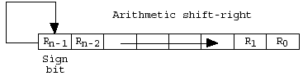
Arithmetic Shift Right
Arithmetic right-shift: Rn-1 remains unchanged;
Rn-2 receives Rn-1, Rn-3 receives Rn-2, so on.
For a negative number, 1 is shifted from the sign bit to the right. A negative number is represented by the 2’s complement. The sign bit remained unchanged.

Slide 58
Arithmetic Shift Right
Arithmetic Shift Right :
Example 1
0100 (4) →
0010 (2)
Example 2
1010 (-6) →
1101 (-3)

Slide 59
Arithmetic Shift Left
The operation is same with Logic shift-left
The only difference is you need to check overflow problem
Carry out
Sign bit
LSB
LSB
R_{n-1}
R_{n-2}
0 insert
Vs=1 : Overflow Vs=0 : use sign bit

Slide 60
Arithmetic Shift Left
Arithmetic Shift Left :
Example 1
0010 (2) →
0100 (4)
Example 2
1110 (-2) →
1100 (-4)

Slide 61
Arithmetic Shift Left
Arithmetic Shift Left :
Example 3
0100 (4) →
1000 (overflow)
Example 4
1010 (-6) →
0100 (overflow)

